Slide 1




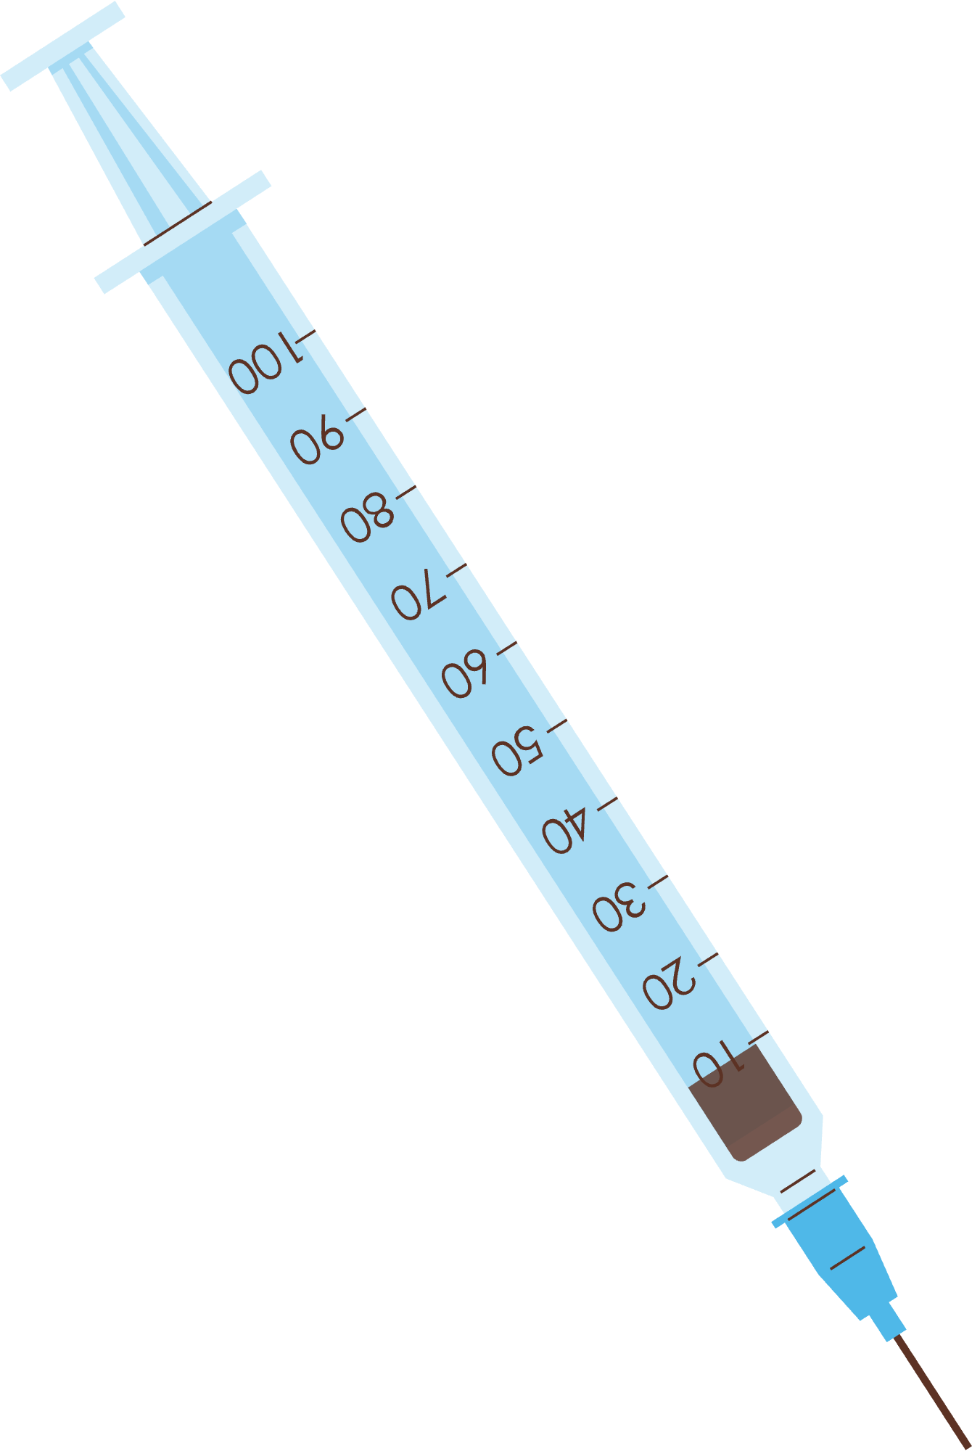

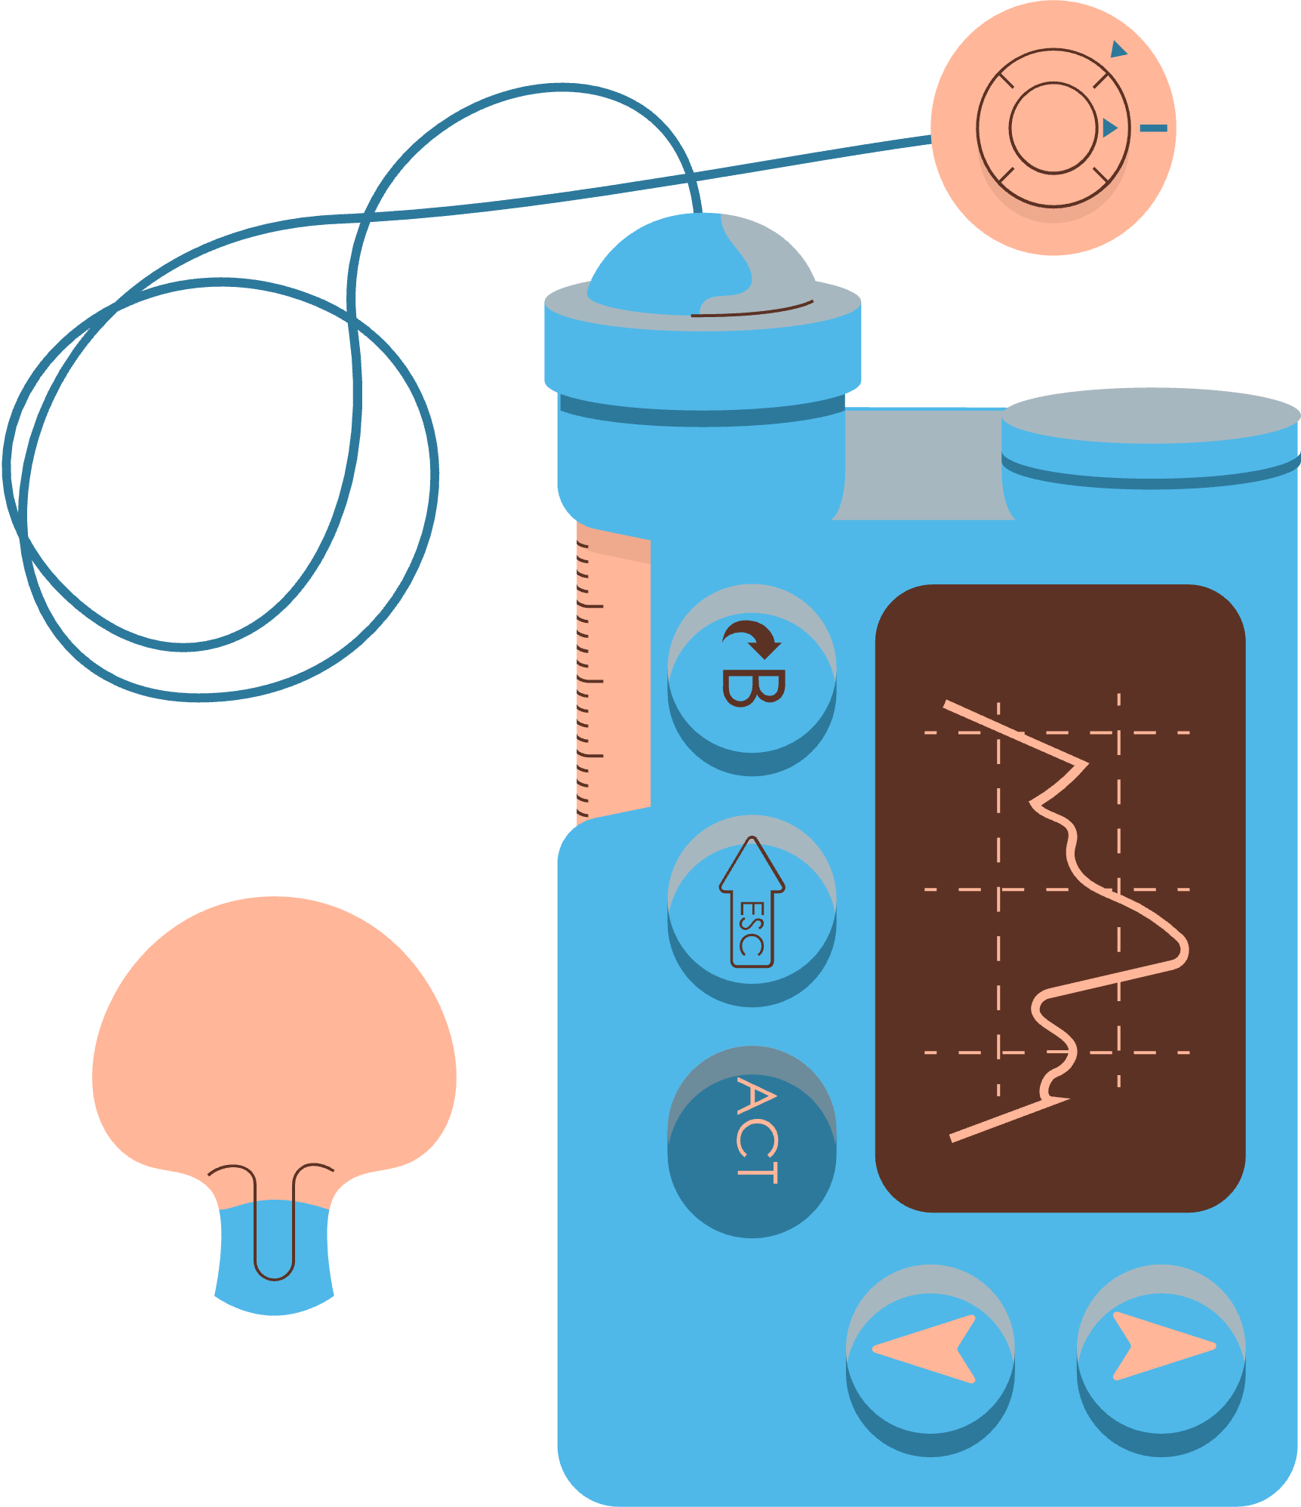



SUGAR, SPICE, AND EVERYTHING NICE: PREDICTING DIABETES RISK USING ENSEMBLE TECHNIQUES AND EXPLAINABLE ARTIFICIAL INTELLIGENCE
Applied Physics 157 Final Project
Andrea Rose V. Franco

Slide 2






DIABETES
The only method of preventing diabetes complications is to identify and treat the disease early (Vijavan et al. 2015)
Franco: Predicting diabetes risk using ensemble techniques and explainable artificial intelligence
Slide 1

Slide 3

MACHINE LEARNING
Utilized to forecast diseases
Comparison of classifiers:
Early-stage risks of diabetes and ensemble techniques were found with higher accuracy.
Franco: Predicting diabetes risk using ensemble techniques and explainable artificial intelligence
Slide 2

Slide 4
OBJECTIVES
Compare three ensemble techniques: Bagging, Random Forest, and XGBoost in making diabetes risk predictions
Explain the model predictions using an Explainable AI approach (SHAP value)
Franco: Predicting diabetes risk using ensemble techniques and explainable artificial intelligence
Slide 3

Slide 5

Data collection and pre-processing
Training the machine learning models
METHODOLOGY
Compare model metrics
Feature Importance
Explainative AI for analysis
Franco: Predicting diabetes risk using ensemble techniques and explainable artificial intelligence
Slide 4

Slide 6
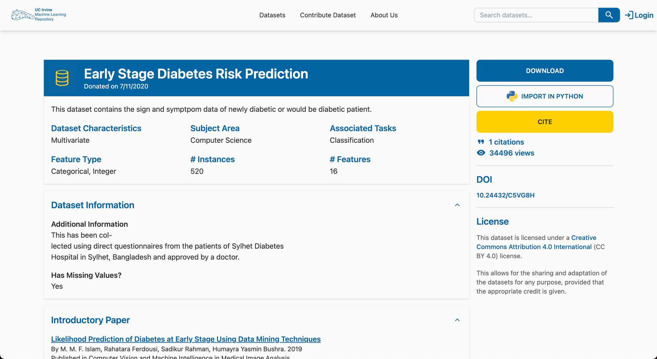
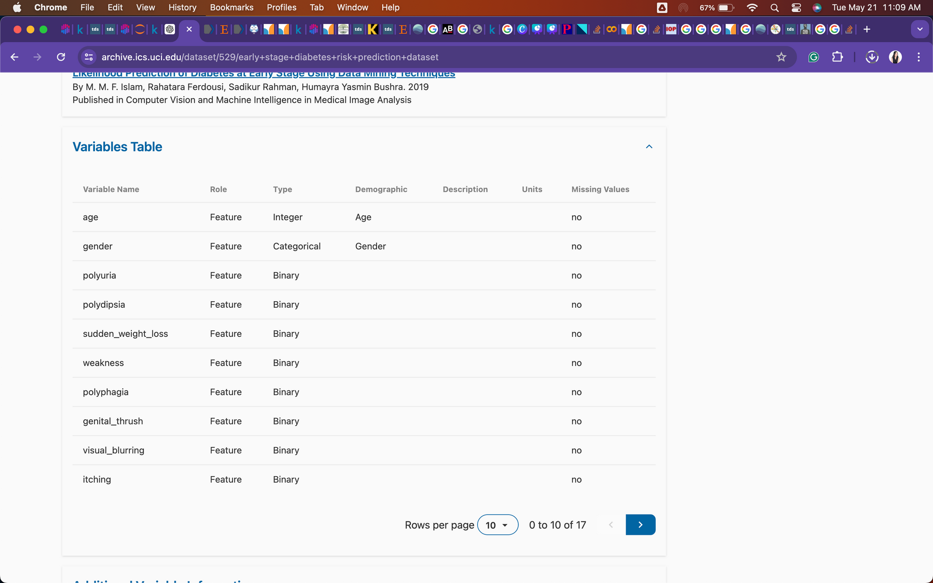
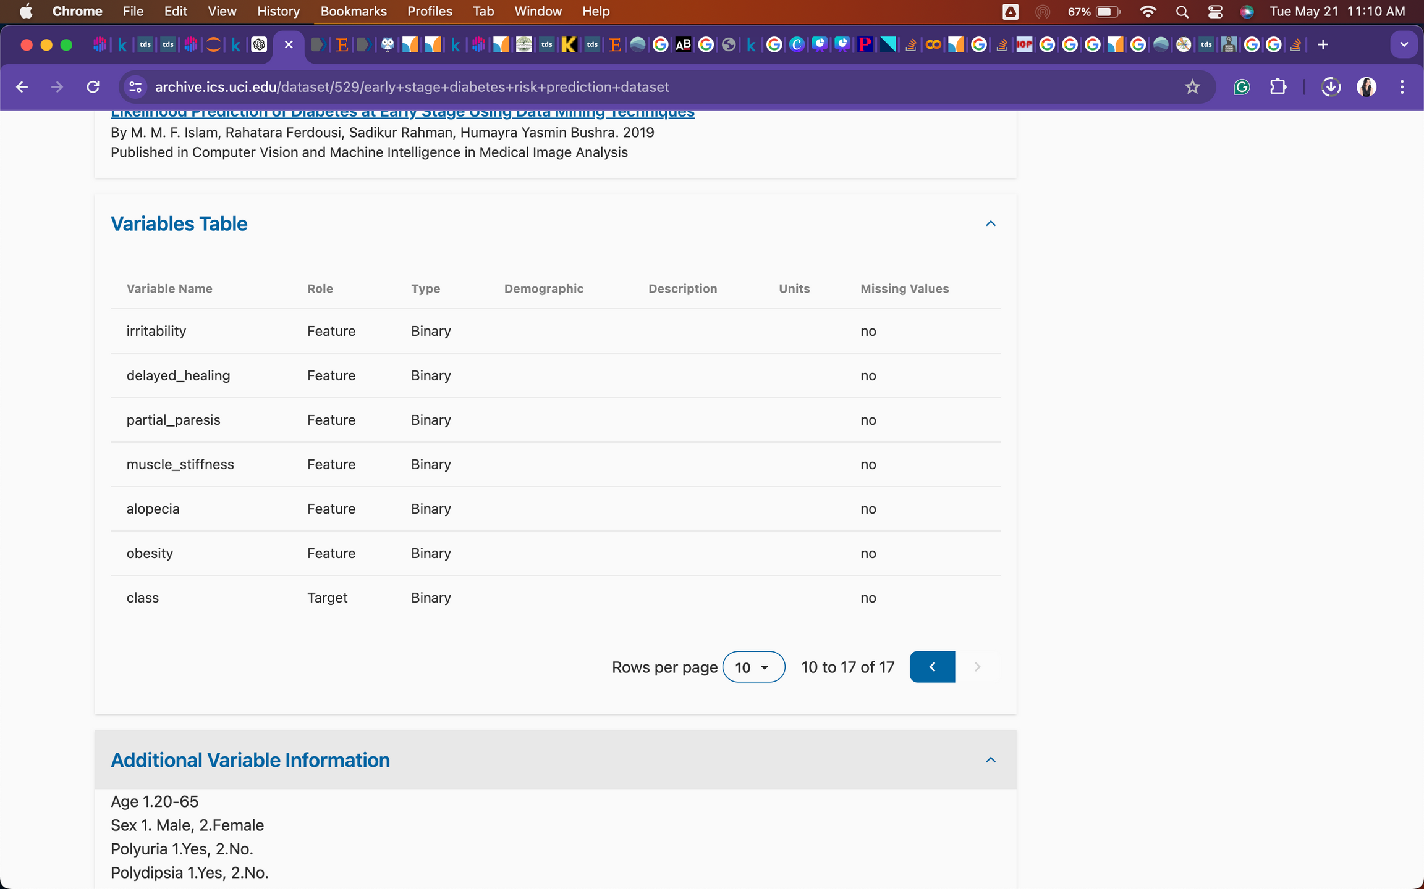
DIABETES DATA
520 patients
16 Features
Target variable: Positive or negative
Link: https://archive.ics.uci.edu/dataset/529/early+stage+diabetes+risk+prediction+dataset
Franco: Predicting diabetes risk using ensemble techniques and explainable artificial intelligence
Slide 5

Slide 7
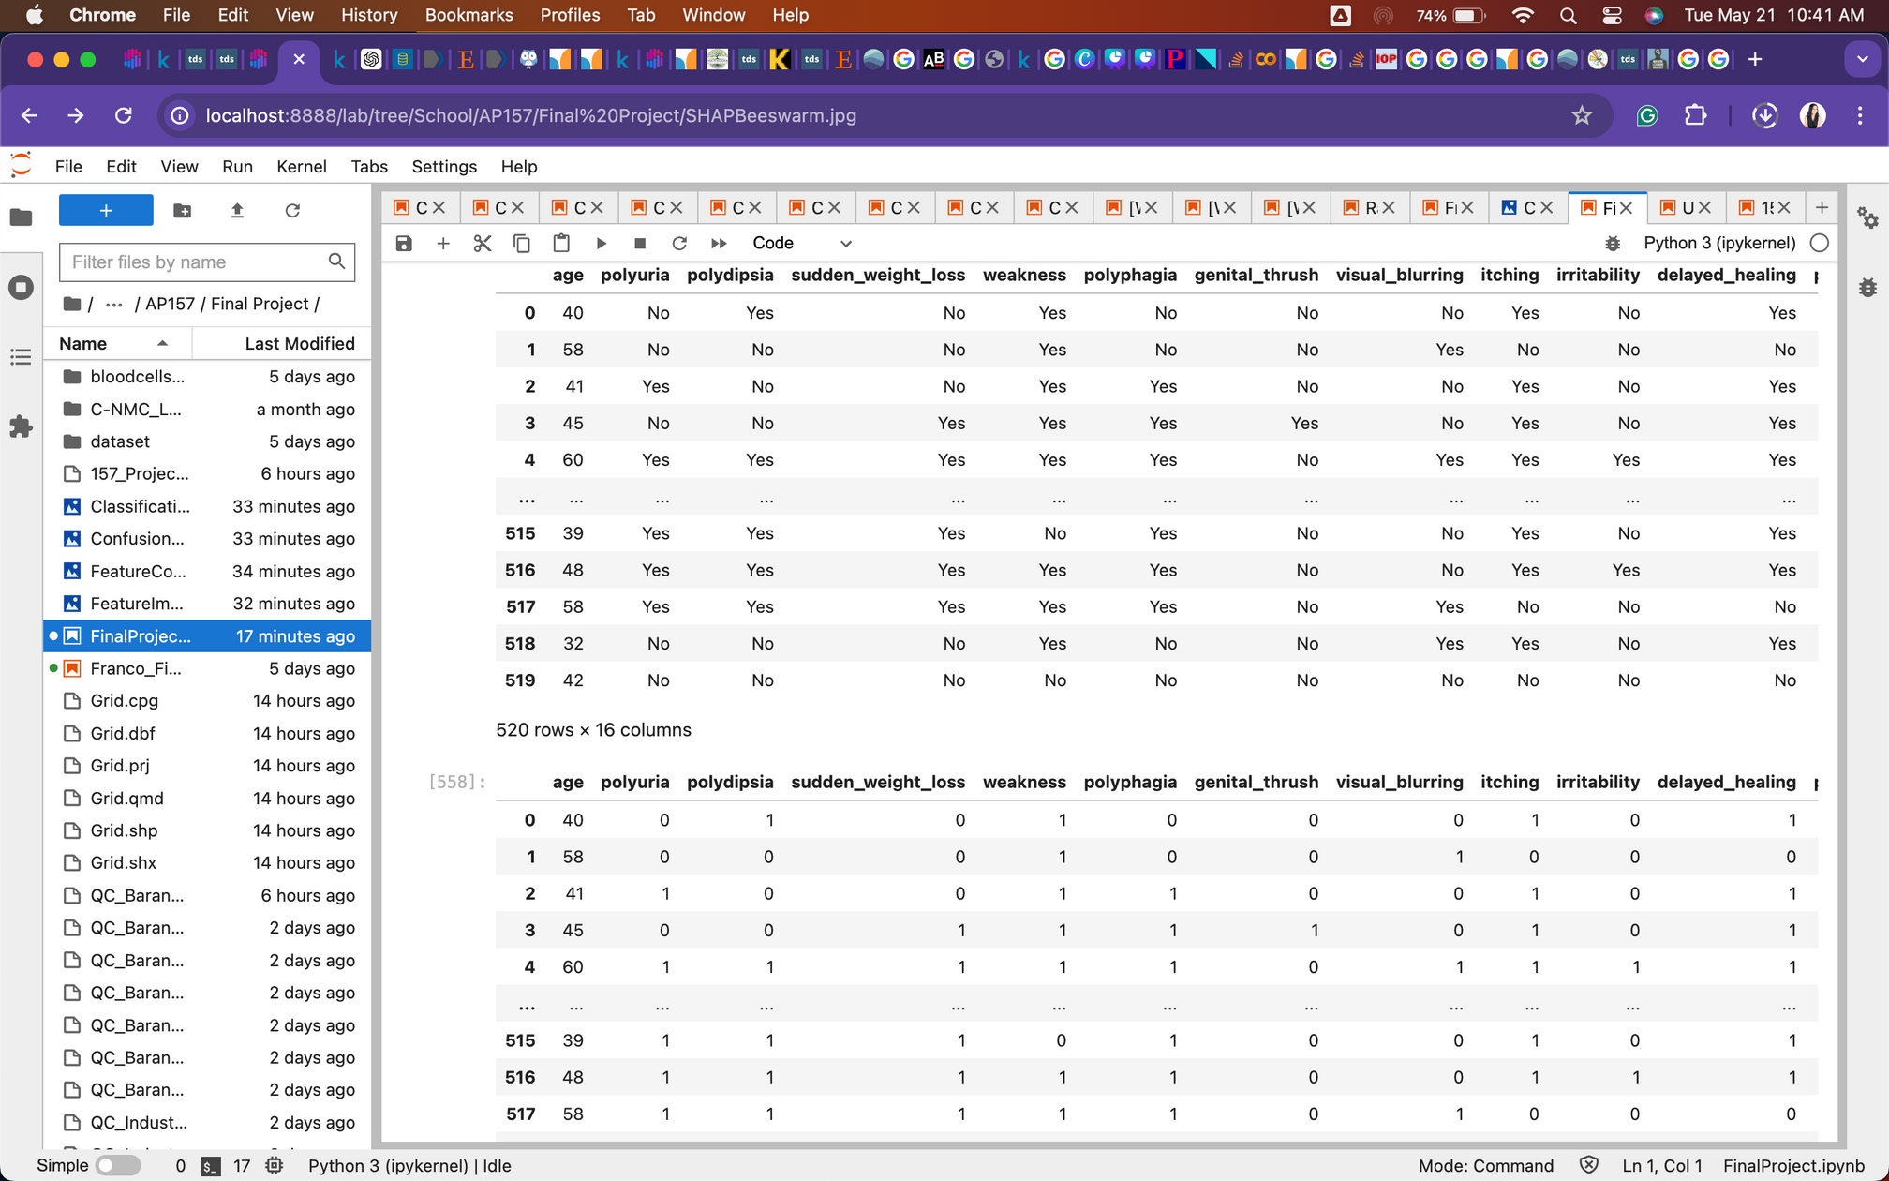
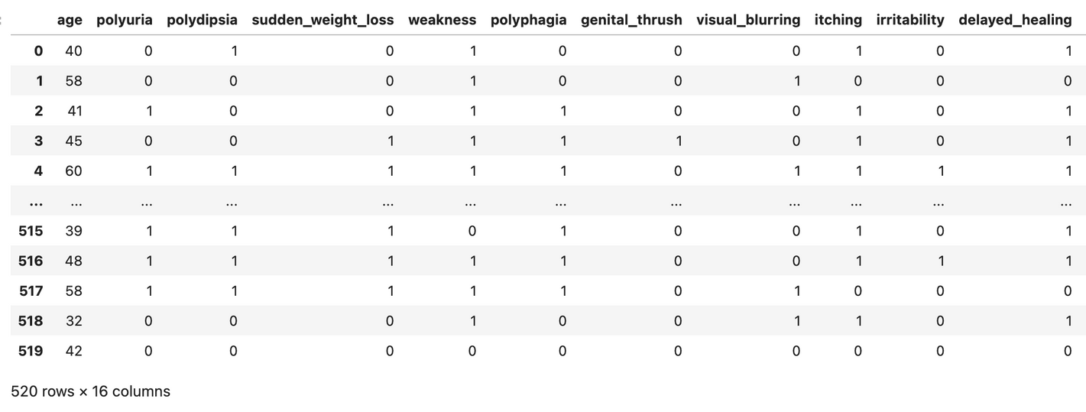
PRE-PROCESSING
Original dataset
Dataset with 0 or 1 for binary features
Franco: Predicting diabetes risk using ensemble techniques and explainable artificial intelligence
Slide 6

Slide 8
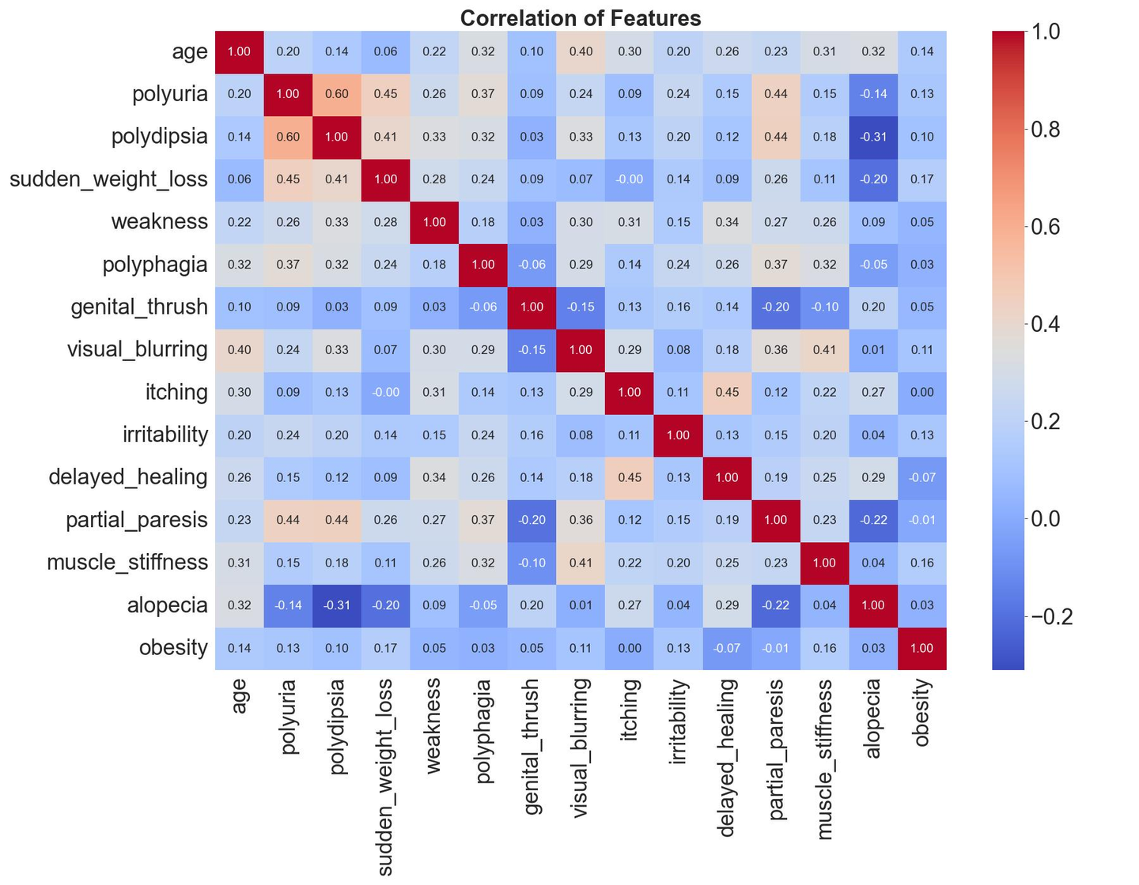
FEATURE CORRELATION
Franco: Predicting diabetes risk using ensemble techniques and explainable artificial intelligence
Slide 7

Slide 9
MODEL TRAINING
80% Training, 20% Testing
BaggingClassifier, RandomForestClassifier, XGBClassifier
default parameters
number of trees: 1000
VALIDATION
 | Bagging | Random Forest | XGBoost
5-fold Cross Validation Score | 0.9568 | 0.9688 | 0.9592
Out-of-bag score | 0.9615 | 0.9688 | -
Franco: Predicting diabetes risk using ensemble techniques and explainable artificial intelligence
Slide 8

Slide 10
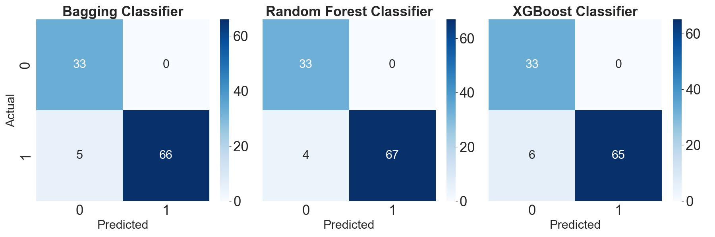
CONFUSION MATRIX
Franco: Predicting diabetes risk using ensemble techniques and explainable artificial intelligence
Slide 9

Slide 11
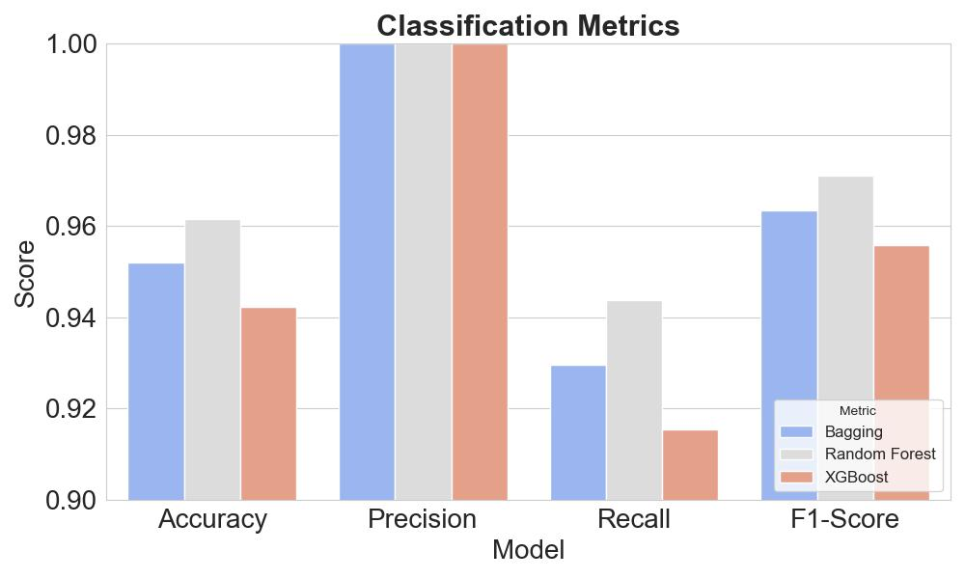
Franco: Predicting diabetes risk using ensemble techniques and explainable artificial intelligence
Slide 10

Slide 12
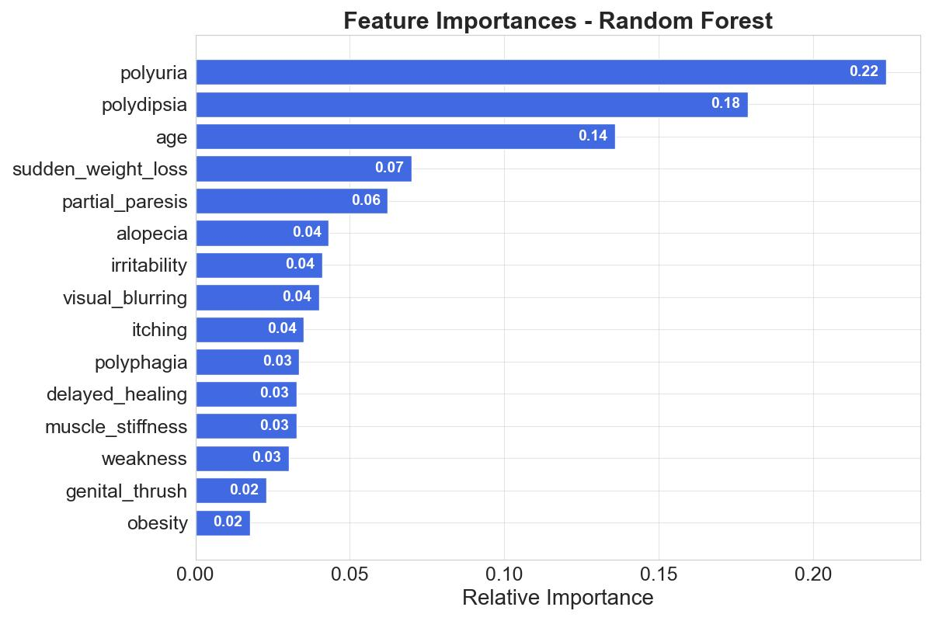
FEATURE IMPORTANCE
Franco: Predicting diabetes risk using ensemble techniques and explainable artificial intelligence
Slide 11

Slide 13
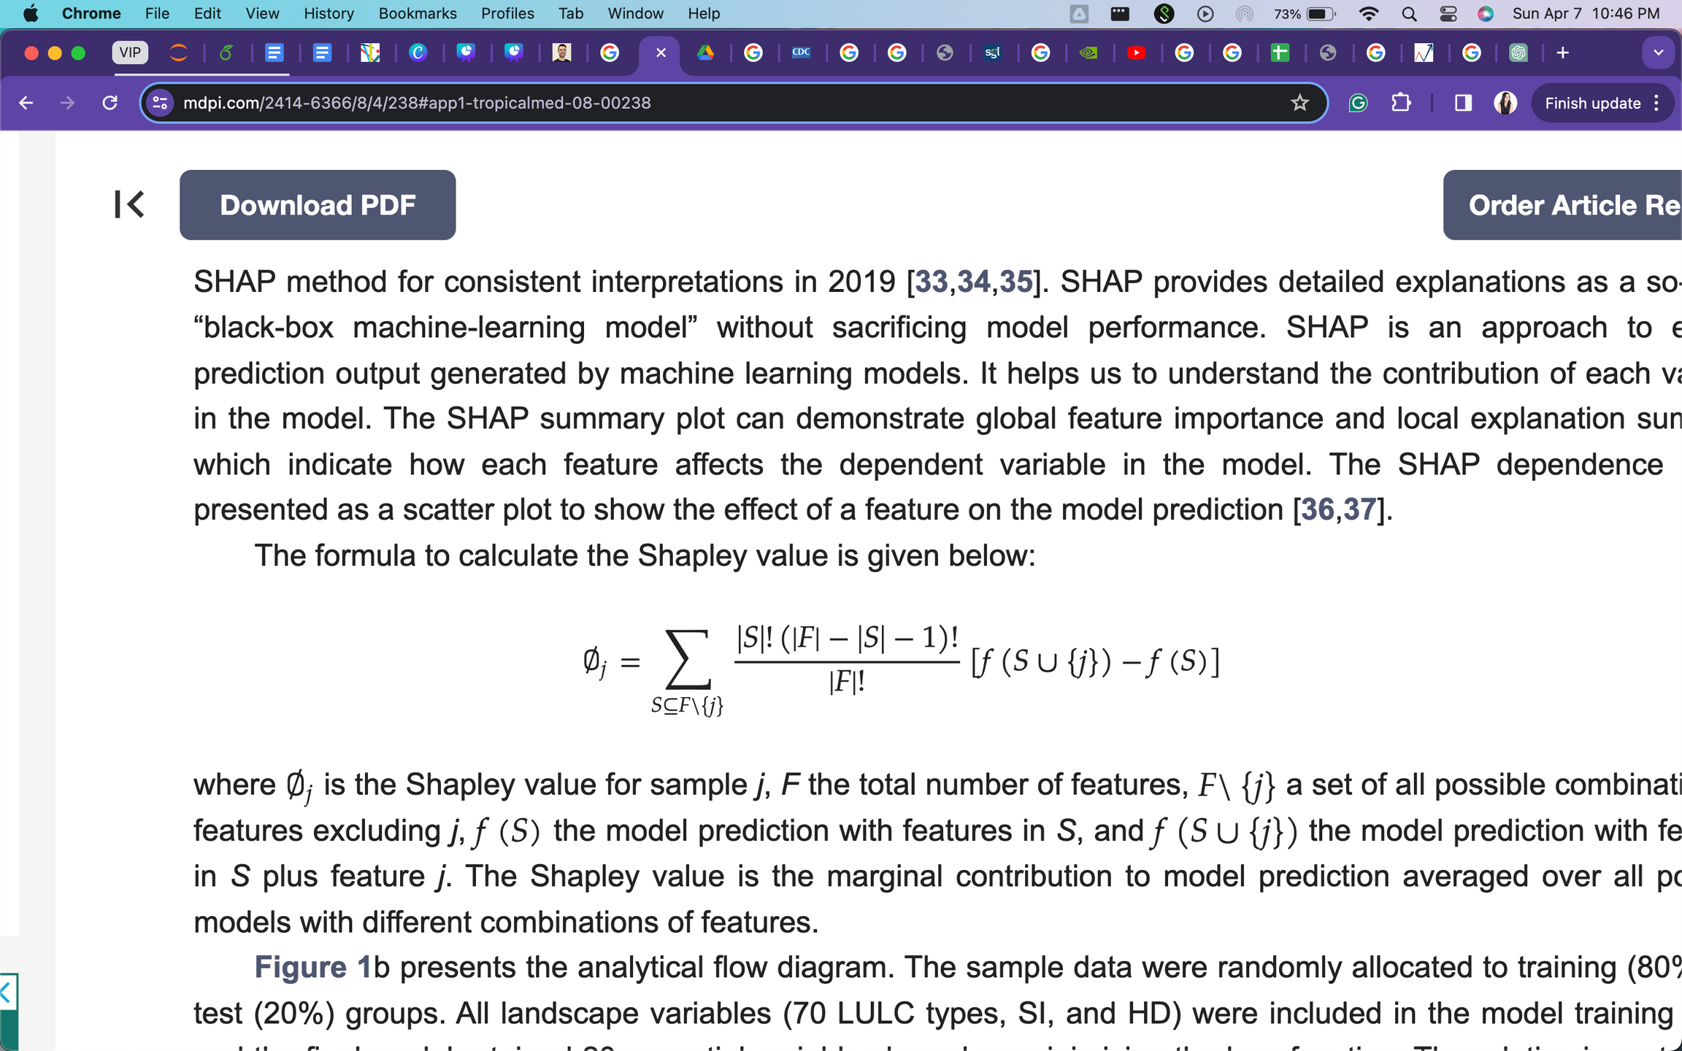
SHAPLEY ADDITIVE VALUES (SHAP)
an approach to explain prediction output generated by machine learning models
Shapley value:
Positive SHAP value = positive association with diabetes
weight
marginal contribution of feature j
all features except j
Franco: Predicting diabetes risk using ensemble techniques and explainable artificial intelligence
Slide 12

Slide 14
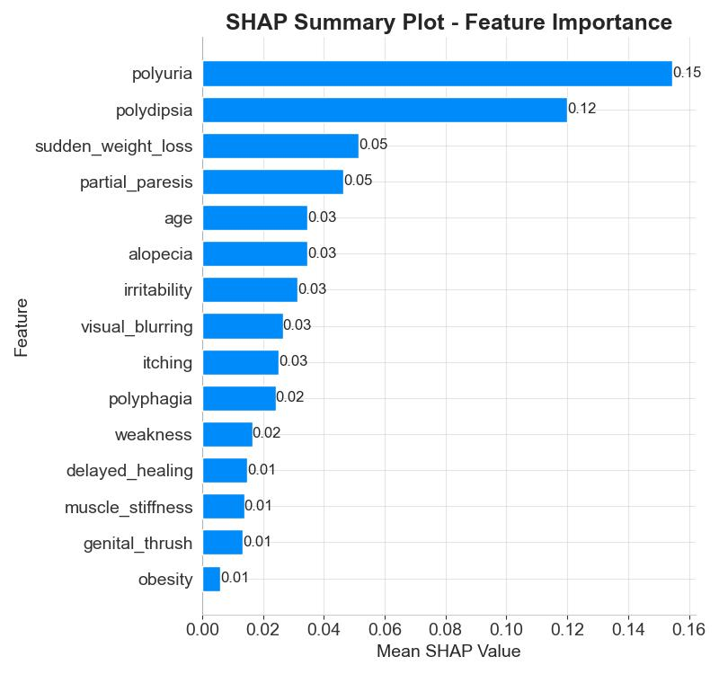
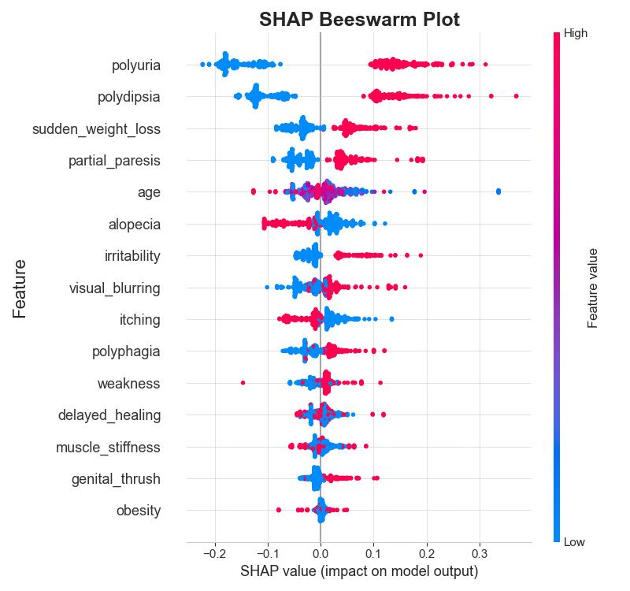
SHAP SUMMARY PLOTS
Franco: Predicting diabetes risk using ensemble techniques and explainable artificial intelligence
Slide 13

Slide 15


SUMMARY
Compared three ensemble machine learning techniques
Random Forest has highest accuracy
Used SHAP to explain random forest predictions
LIMITATIONS
Basis for model parameters
Cross-validation parameters
Franco: Predicting diabetes risk using ensemble techniques and explainable artificial intelligence
Slide 14

Slide 16
FUTURE WORK
Increase number of features
Hypertune parameters of models
Franco: Predicting diabetes risk using ensemble techniques and explainable artificial intelligence
Slide 15

Slide 17
THANK YOU!
Reference:
Vijayan V.V., Anjali C. Prediction and diagnosis of diabetes mellitus—A machine learning approach; Proceedings of the 2015 IEEE Recent Advances in Intelligent Computational Systems (RAICS); Kerala, India. 10–12 December 2015; pp. 122–127

